Slide 1
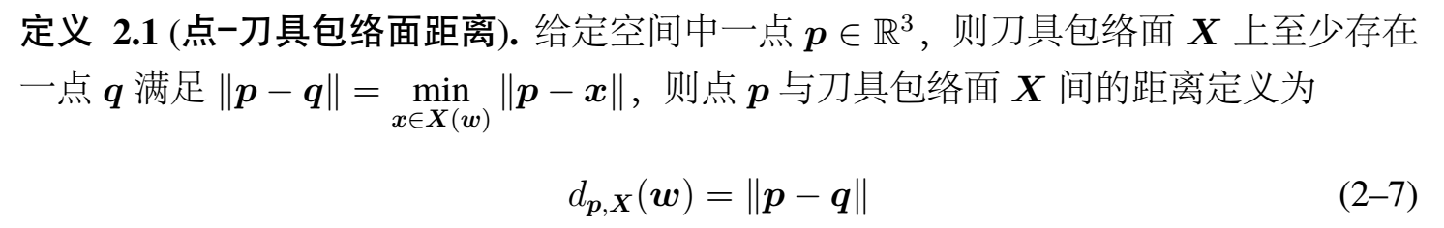
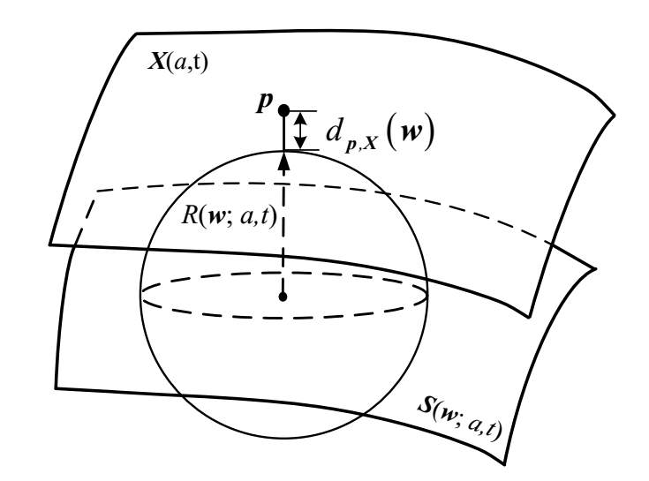



$$d_{p,X\left(ω\right)}=\left\|P_{i}−S\left(w;a,t\right)\right\|−r\left(a,t\right)$$
简单工程曲面：平面、柱面、锥面、球面……
$d\left(p,w\right)有$解析表达式
点面距离
复杂工程曲面：椭球面、抛物面、双曲面、
Bezier曲面、B样条曲面……
$d\left(p,w\right)无$解析表达式

Slide 3


Slide 9
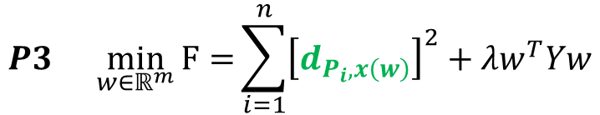

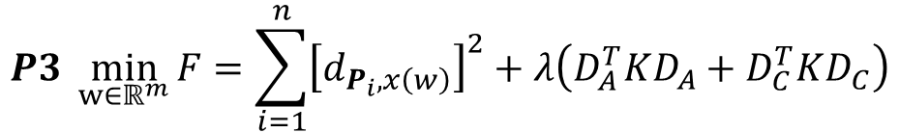


误差项（几何偏差）
光顺项
$$P3 \min_{w∈ℝ^{m}}{F=\sum_{i=1}^{n}{{\left[d_{P_{i},x\left(w\right)}\right]}^{2}+λ\left(D_{A}^{T}KD_{A}+D_{C}^{T}KD_{C}\right)}}$$
变量（非线性）
$$P3 \min_{w∈ℝ^{m}}{F=}\sum_{i=1}^{n}{{\left[d_{P_{i},x\left(w\right)}\right]}^{2}+λw^{T}Yw}$$
变量
$$d_{P_{i},x\left(w\right)}≈d_{P_{i},x\left(w^{k}\right)}+{\left(∆w^{k}\right)}^{T}∇d_{P_{i},X\left(w^{k}\right)}$$
$$w≈w^{k}+∆w^{k}$$
$$O\left(x^{2}\right)$$
$$P3 \min_{w∈ℝ^{m}}{F=}\sum_{i=1}^{n}{{\left[d_{P_{i},x\left(w^{k}\right)}+{\left(∆w^{k}\right)}^{T}{∇d}_{p_{i},X\left(w^{k}\right)}\right]}^{2}}+λ\left[{\left(w^{k}\right)}^{T}Y\left(w^{k}\right)+2{\left(w_{k}\right)}^{T}YΔw^{k}+{\left(Δw^{k}\right)}^{T}Y\left(Δw^{k}\right)\right]$$

Slide 10
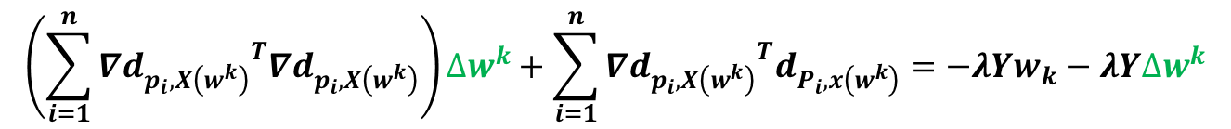

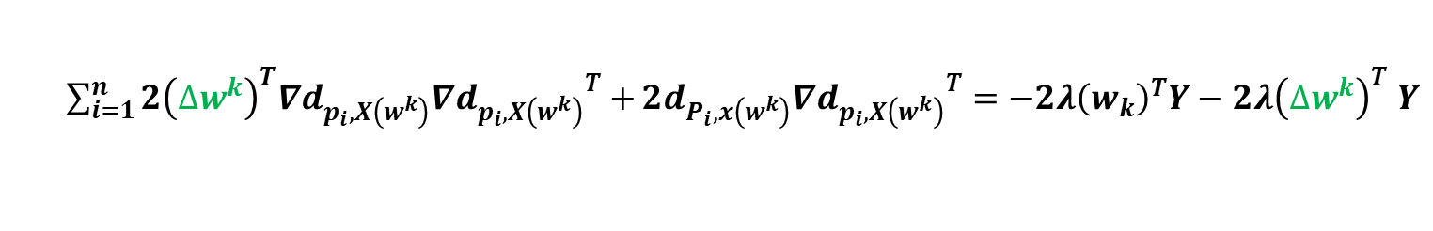

$$\min_{w∈ℝ^{m}}{F=}\sum_{i=1}^{n}{{\left[d_{P_{i},x\left(w^{k}\right)}+{\left(∆w^{k}\right)}^{T}{∇d}_{p_{i},X\left(w^{k}\right)}\right]}^{2}}+λ\left[{\left(w^{k}\right)}^{T}Y\left(w^{k}\right)+2{\left(w_{k}\right)}^{T}YΔw^{k}+{\left(Δw^{k}\right)}^{T}Y\left(Δw^{k}\right)\right]$$
最小二乘问题：
$$\min_{x}{{\left\|Ax−b\right\|}^{2}}$$
$\frac{∂F}{∂{∆w}^{k}}$=0
$$\frac{∂F}{∂∆w^{k}}=\sum_{i=1}^{n}{2\left[d_{P_{i},x\left(w^{k}\right)}+{\left(∆w^{k}\right)}^{T}{∇d}_{p_{i},X\left(w^{k}\right)}\right]}{{∇d}_{p_{i},X\left(w^{k}\right)}}^{T}+2λ{\left(w_{k}\right)}^{T}Y+{\left(∆w^{k}\right)}^{T}\left(Y+Y^{T}\right)=0$$
$\sum_{i=1}^{n}{2{\left(∆w^{k}\right)}^{T}{∇d}_{p_{i},X\left(w^{k}\right)}{{∇d}_{p_{i},X\left(w^{k}\right)}}^{T}+}2d_{P_{i},x\left(w^{k}\right)}{{∇d}_{p_{i},X\left(w^{k}\right)}}^{T}=−2λ{\left(w_{k}\right)}^{T}Y−2λ{\left(∆w^{k}\right)}^{T}$ $Y$
$$2{\left(∆w^{k}\right)}^{T}\left(\sum_{i=1}^{n}{{∇d}_{p_{i},X\left(w^{k}\right)}{{∇d}_{p_{i},X\left(w^{k}\right)}}^{T}}\right)+2\sum_{i=1}^{n}{d_{P_{i},x\left(w^{k}\right)}{{∇d}_{p_{i},X\left(w^{k}\right)}}^{T}}=−2λ{\left(w_{k}\right)}^{T}Y−2λ{\left(∆w^{k}\right)}^{T} Y$$
$$\left(\sum_{i=1}^{n}{{{{∇d}_{p_{i},X\left(w^{k}\right)}}^{T}∇d}_{p_{i},X\left(w^{k}\right)}}\right)∆w^{k}+\sum_{i=1}^{n}{{{∇d}_{p_{i},X\left(w^{k}\right)}}^{T}d_{P_{i},x\left(w^{k}\right)}}=−λYw_{k}−λY∆w^{k}$$

Slide 11
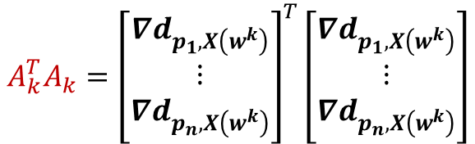
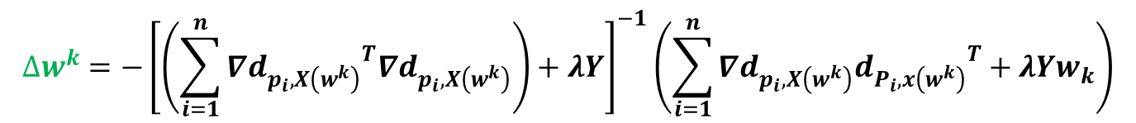

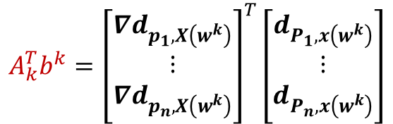
$$∆w^{k}={−\left[\left(\sum_{i=1}^{n}{{{{∇d}_{p_{i},X\left(w^{k}\right)}}^{T}∇d}_{p_{i},X\left(w^{k}\right)}}\right)+λY\right]}^{−1}\left(\sum_{i=1}^{n}{{∇d}_{p_{i},X\left(w^{k}\right)}{d_{P_{i},x\left(w^{k}\right)}}^{T}}+λYw_{k}\right)$$
$$A_{k}^{T}A_{k}={\left[\begin{matrix}{∇d}_{p_{1},X\left(w^{k}\right)} \\ ⋮ \\ {∇d}_{p_{n},X\left(w^{k}\right)}\end{matrix}\right]}^{T}\left[\begin{matrix}{∇d}_{p_{1},X\left(w^{k}\right)} \\ ⋮ \\ {∇d}_{p_{n},X\left(w^{k}\right)}\end{matrix}\right]$$
$$A_{k}^{T}b^{k}={\left[\begin{matrix}{∇d}_{p_{1},X\left(w^{k}\right)} \\ ⋮ \\ {∇d}_{p_{n},X\left(w^{k}\right)}\end{matrix}\right]}^{T}\left[\begin{matrix}d_{P_{1},x\left(w^{k}\right)} \\ ⋮ \\ d_{P_{n},x\left(w^{k}\right)}\end{matrix}\right]$$
$$∆w^{k}=−{\left[A_{k}^{T}A_{k}+λY\right]}^{−1}\left(A_{k}^{T}b^{k}+λYw_{k}\right)$$
END

Slide 12
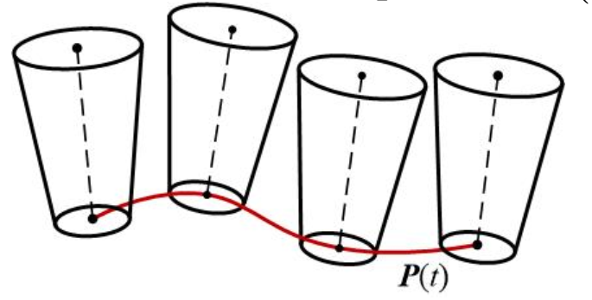



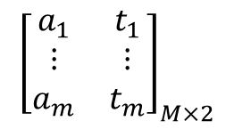




$$S_{axis}\left(w;a,t\right)=P\left(t\right)+a∙H∙O\left(t\right)$$
$${\left[\begin{matrix}a_{1} & t_{1} \\ ⋮ & ⋮ \\ a_{m} & t_{m}\end{matrix}\right]}_{M×2}$$
$$a$$
$$t$$
$$S_{i}^{′}$$
$$P_{i}$$
$$a$$
$$S_{i}^{′}$$
$$t$$
$$f\left(a,t\right)=\left\|P_{i}−S\left(w;a,t\right)\right\|−r\left(a,t\right)+μ∙f_{penalty}\left(a,t\right)$$

Slide 13
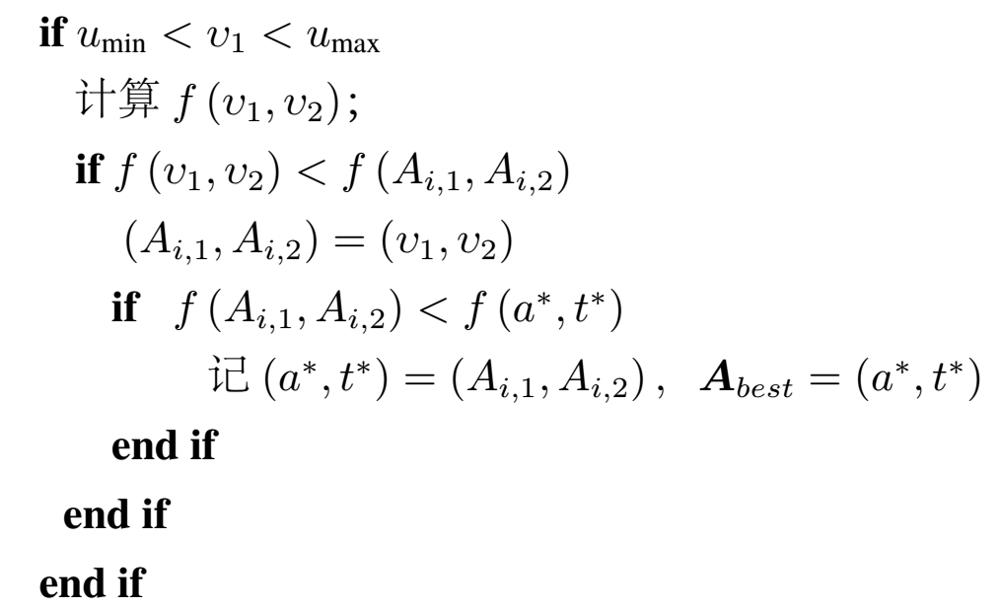
$$select P_{1},P_{2}∈A_{\left\{1,2,⋯,M\right\}} excludedA_{i}$$
该值在参数范围内
该值忧于当前对应值
该值优于当前全局最优值

